Slide 1
Project-[#]: [Project Title]
Project Kickoff
[Date]

Slide 3
Agenda
Background
Project Purpose
Communication Plan
Stakeholders
Communication
Key Dates
Budget
Project Roles
Team Norms
Project Approach
Risks to Project Success
Open Questions
Next Steps

Slide 4
Background
[Item]
[Item]
[Item]

Slide 5
Project Purpose
Major Objectives
[Item]
[Item]
[Item]
Success Criteria
[Item]
[Item]
[Item]

Slide 6
Communication Plan*
Key Project Teams & Members
Executive Sponsor
Executive Steering Committee (ESC)
Business Owner
Project Leadership Team (PLT)
AAFP Project Core Team
Other Key AAFP Resources
Business Project Manager
IT Project Manager
Vendor Project Manager
*NOTE: You can use these two Communication Plan slides instead of some of the individual slides that follow, depending on what works best for the project.

Slide 7
Communication Plan
Key Meetings & Review Process
Executive Steering Committee (ESC) Meeting | Bi-Monthly | See Previous Slide
Project Leadership Team (PLT) Meeting | Monthly | See Previous Slide
Project CORE Team Meeting | Weekly and As-Needed | AAFP Project Core Team
Update in 10-Block Format | Monthly | Business & IT Project Managers, IT PMO
Project Status Reports | Weekly | Business & IT Project Managers, IT PMO
Project Tasks and Meeting Notes | Daily/As-Needed | AAFP Project Core Team
Update to All Staff via The Source/Pulse+ | Quarterly | Business and IT Project Managers
Update to Cross-divisional Integration Team | Monthly | Business and IT Project Managers

Slide 8
Stakeholders
Executive Sponsor: [Name]
Key Stakeholders
[Name]
[Name]
[Name]

Slide 9
Communication
Day-to-day activities documented in JIRA
[link to main JIRA ticket]
“Watchers” will receive automatic updates from JIRA whenever project ticket is updated
[If applicable:]Starting in [month], all stakeholders will receive monthly update on project status via email
IT will ask team members for feedback at conclusion of project so we can improve processes for future projects

Slide 10
Key Dates
Milestone Date
[Item] March 1, 2015
[Item] July 1, 2015
[Item] November 1, 2015
[Item] July 1, 2016

Slide 11
Budget
[Item]
[Item]
[Item]

Slide 12
Project Roles
Project Team
Name Responsibility Division
[Name] [Primary Responsibility] [Division Name]
[Name] [Primary Responsibility] [Division Name]
[Name] [Primary Responsibility] [Division Name]

Slide 13
Project Roles
Key Contributors
Pulled in as needed to work on specific phases/tasks
Name Responsibility Division
[Name] [Primary Responsibility] [Division Name]
[Name] [Primary Responsibility] [Division Name]
[Name] [Primary Responsibility] [Division Name]

Slide 14
Team Norms
Team members unable to attend a meeting are responsible for providing updates and input prior to the meeting
Team members share responsibility for the success of the project
Team will operate under the principle “If you oppose, propose”
Issues that cannot be resolved by the team will be escalated by the project manager to the executive sponsor
[If meeting times/frequency are known, include that information]
[Consider addressing how you want team members to report absences and communicate planned time off]
[Add other items if needed]

Slide 15
Project Approach
[Given our focus on Agile going forward, this template includes information about Agile only; replace/modify this info as needed]
[Info about Agile is intended only as high-level overview; you will need to provide more detail later as the team begins working together]
[This template includes two visual representations of Agile process; choose the one with the level of detail you prefer and delete the other one]

Slide 16
Project Approach
Project team will follow principles of Agile software development
What does that mean?
Expressing requirements in simple statements (called “user stories”)
Setting clear priorities
Following strict cycle of releases (called “sprints”)
Collaborating closely on project tasks
Reviewing results regularly and adjusting plans based on feedback
Committing to process improvement

Slide 17
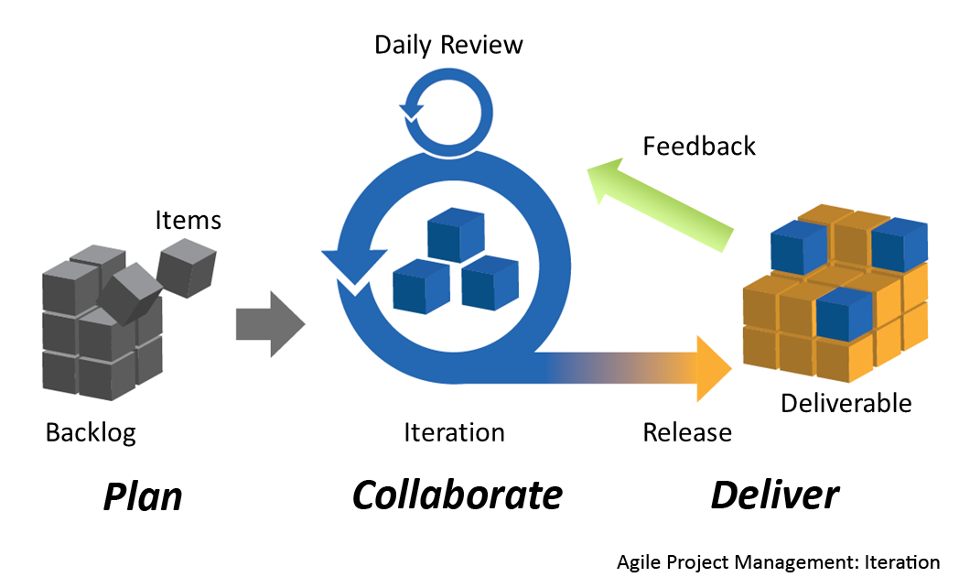

Slide 19
Risks to Project Success
[Item]
[Item]
[Item]

Slide 20
Open Questions
[Item]
[Item]
[Item]

Slide 21
Next Steps
[Item]
[Item]
[Item]

Slide 24
